Slide 1


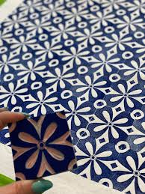
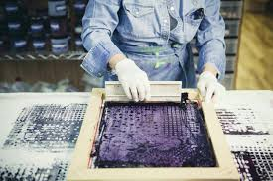


Name |  | Marking Date | Key Stage | Exceeding |  | Meeting |  | Developing
Group |  |  | 3 | Theory | Practical | Theory | Practical | Theory | Practical
Year 7
Printing Project
Use this checklist to focus your work and to check the effectiveness of your work
R | I am not confident I could answer a question on this topic. I need to check with my teacher and ensure I have what I need to do it.
A | I am not too sure about this topic. I may need to check with my teacher and spend more time working on it.
G | I am confident about this topic and I know what I need to do.
Topic/Unit Focus | Student
 | R | A | G
Health and Safety
Critiqued the work of Lucienne Day
Producing a repeat pattern
Using a sewing machine - threading it up
Using a sewing machine - driving test
Embroidery sample stitches
Topic/Unit Focus | Student
 | R | A | G
Developed a design idea
Annotation of design ideas
Making wall hanging - accuracy
Making wall hanging - embroidery
Making wall hanging - final outcome
Evaluation
Strengths | Targets
You have explained what you like and dislike about Day’s work You know how to set up a sewing machine You have produced repeat patterns You have produced a sample of embroidery You have created two initial designs You have developed a final design idea You have annotated your design ideas in detail Your wall hanging incorporates a repeat pattern Your wall hanging incorporates embroidery You have completed your final piece You have written a detailed evaluation | Complete your likes and dislikes about Day’s work ensuring it is detailed and informative Practice setting up the sewing machine yourself Practice producing accurate repeat patterns Practice getting accurate embroidery stitches Complete your chosen initial design ideas Complete your final design idea Complete the annotation of your design ideas in detail Produce accurate and uniform embroidery stitches Use your time productively to finish your final piece Ensure your evaluation is completed and detailed
Response to Feedback

