Slide 1


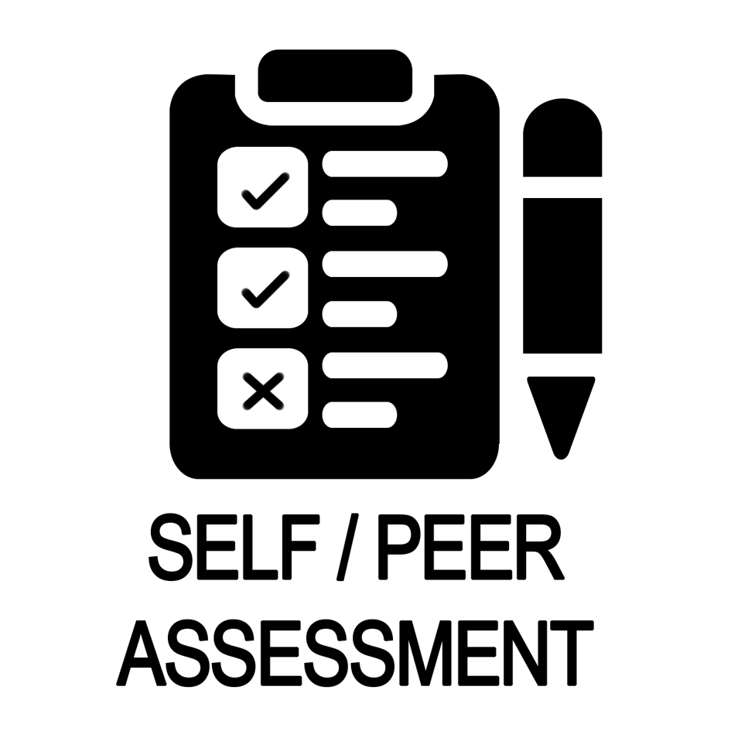



Name |  | Marking Date | Key Stage | Exceeding |  | Meeting |  | Developing
Group |  |  | 3 | Theory | Practical | Theory | Practical | Theory | Practical
Year 8
Graphical Textiles Project
Use this checklist to focus your work and to check the effectiveness of your work
R | I am not confident I could answer a question on this topic. I need to check with my teacher and ensure I have what I need to do it.
A | I am not too sure about this topic. I may need to check with my teacher and spend more time working on it.
G | I am confident about this topic and I know what I need to do.
Topic/Unit Focus | Student
 | R | A | G
Health and Safety
Artist research page on Picasso
Using a sewing machine - threading it up
Using a sewing machine - seam sample
Production of tie dye
Development of design ideas
Topic/Unit Focus | Student
 | R | A | G
Annotation of design ideas
Making cushion - graphical designs
Making cushion - accuracy of seams
Making cushion - accuracy of hems
Making cushion - final outcome
Evaluation
Strengths | Targets
You have written a detailed research page about Picasso You know how to set up a sewing machine You have completed a range of graphical designs You have completed a sample of a seam You have two initial design ideas You have developed a final design idea You have annotated your design ideas in detail You have neatly hemmed your tie dye Your cushion incorporates your graphical designs Your cushion incorporates patchwork You have completed your final piece You have written a detailed evaluation | Complete your research of Picasso ensuring it is detailed and informative Practice setting up the sewing machine yourself Practice producing graphical designs Complete your initial & developed design ideas Complete the annotation of your design ideas in detail Stitch your seams more accurately Remember the seam allowance is 15mm, to get a quality finish Your hem should only be 10mm in depth Use your time productively to finish your final piece Ensure your evaluation is completed and detailed
Response to Feedback

