Slide 1





Teacher’s slide
Key lesson information
Location | Classroom with student access to internet
Recommended time | 60 minutes
Objectives | By the end of the session, students should be able to: Identify a learning pathway they’d like to explore further Name pathways, qualifications, skills, and progression opportunities related to an example career State sources of further information about learning pathways
Main student tasks | Rate their familiarity with learning pathways Identify sources of information to research learning pathways Read a career profile using the Unifrog Careers library Create a table of the entry routes, skills, qualifications, and progression opportunities related to a chosen career Write a reply to a student who holds a misconception about learning pathways
Keywords | Learning pathways, career goals, skills, qualifications, career progression
Know-how library
Open the ‘student side’ of your Unifrog account and click these links: FE college, UTC, apprenticeship, HTQ, or university? University and apprenticeships: what’s the difference? Students can also search for these guides using the Know-how library tool.
Tracking progress on Unifrog
Add as an Interaction | Click Advanced view>Sort by school leaving year>[filter for specific students]>+interaction.
Track on Charts | Click Usage charts you can customise>Careers library: favouriting over time / Most popular career areas / Most popular career profiles.
Tracking individual students | Advanced view>Sort by>Library profiles in Favourites.
Teacher preparation
Provide | Computer and internet access, digital workbook
Familiarise yourself | Open the ‘student side’ of your Unifrog account and click this link: Careers library
Benchmarks and standards
CDI Framework | Explore possibilities
PSHE Association | Choices and pathways, learning skills
ISCA | C:A2:4; C:B1:5
Skills | Planning / aiming high

Slide 2

What comes after school: the main learning pathways

Slide 3

Looking beyond school (5 mins)
After school, some options for the next steps of your career journey are:
FE college
Sixth form
Apprenticeship
University
Employment
Volunteering
For each pathway, write down your rating of how much you know about it.
I know nothing about this pathway
I know a little about this pathway
I know quite a bit about this pathway
I know lots about this pathway
Finished? For the pathway you know the most about, try to summarise it in under 30 words, to help someone who doesn’t know much about it.
Notes:
Teacher’s notes:
The purpose of the starter activity is for students to reflect on how informed they feel about each pathway, e.g. university: 2.
You may wish to reiterate to students that it’s absolutely fine if they rate some (or all) pathways as 1 or 2 in this point in their career journey. By following the Unifrog Careers Year Plan spiral curriculum, students should gain a deeper understanding of the pathways over time.

Slide 4




How do I find out more? (10 mins)
Select one of the pathways that you rated low (1 or 2) in the starter activity:
FE college
Sixth form
Apprenticeship
University
Employment
Volunteering
Create a list of at least three ways you could find out more information about this pathway.
Who could you talk to?
Where could you go?
What websites could you use?
Notes:
Teacher’s notes:
Suggested answers: Click to reveal on the next slide.
Unifrog search tools (e.g. UK universities tool)
Unifrog Know-how library guides
Unifrog webinars
Provider websites (e.g. individual university websites)
Provider open days and events
Career fairs at school
Careers lessons at school
Virtual career fairs, e.g. Unifrog university fair
School staff who’ve followed the pathway themselves
Careers adviser/leader
Family/friends who’ve followed the pathway themselves
Classmates who rated their knowledge highly in the previous activity

Slide 5
How do I find out more?
You might have considered sources of information such as…
Unifrog search tools
Unifrog guides
Webinars
Provider websites
Open days and events
Career fairs
Virtual career fairs
Careers lessons
Teachers / school staff
Careers adviser
Family / friends
Classmates
Notes:
Teacher’s notes:
Suggested answers:
Unifrog search tools (e.g. UK universities tool)
Unifrog Know-how library guides
Unifrog webinars
Provider websites (e.g. individual university websites)
Provider open days and events
Career fairs at school
Virtual career fairs, e.g. Unifrog university fair
Careers lessons at school
School staff who’ve followed the pathway themselves
Careers adviser/leader
Family/friends who’ve followed the pathway themselves
Classmates who rated their knowledge highly in the previous activity

Slide 6


How do I find out more?
Now, find someone else who selected the same pathway as you.
FE college
Sixth form
Apprenticeship
University
Employment
Volunteering
Compare your lists and discuss:
Which do you think would be the most useful source of information and why?
Which do you think would be the least useful source of information and why?
Could any sources of information be biased?
Notes:
Teacher’s notes:
Delete ‘find someone else who has selected the same pathway as you’ if you’d prefer students to work independently or if you’d prefer to allocate students into pairs yourself.

Slide 7
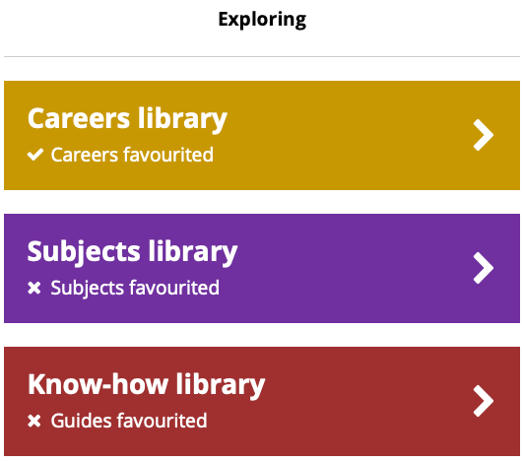

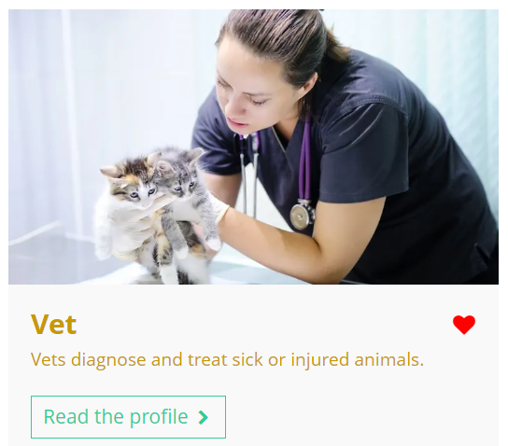


Using the Unifrog Careers library (10 mins)
Log in to your Unifrog account and open the Careers library.
Browse the library to identify a career you’d like to have at some point in your life and write it at the top of your page.
Vet
Remember to click the heart icon to add the career profile to your favourites.
Notes:
Teacher’s notes:
Go to Unifrog > Student side > Careers library.
Tracking students’ progress:
You can track student progress with favouriting career profiles by clicking Advanced>Sort by>Library profiles in Favourites.
From your homepage, you can also create charts showing the careers that have been favourited. Go to Usage charts you can customise>Careers library: favouriting over time / Most popular career areas / Most popular career profiles.

Slide 8
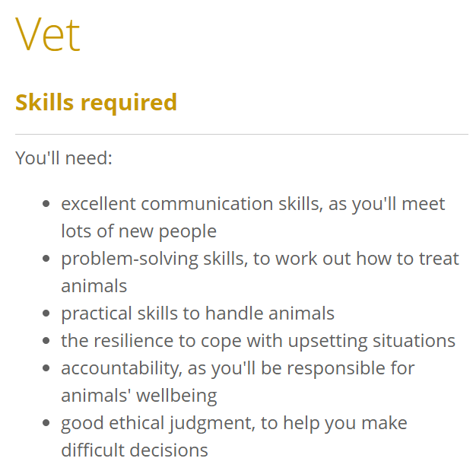

Using the Unifrog Careers library
Read the career profile, paying particular attention to the following sections:
Career path and progression
Skills required
Entry requirements
Related university subject profiles
You’ll use this information in the next activity!
Notes:
Teacher’s notes:
Go to Unifrog > Student side > Careers library.
Tracking students’ progress:
You can track student progress with favouriting career profiles by clicking Advanced>Sort by>Library profiles in Favourites.
From your homepage, you can also create charts showing the careers that have been favourited. Go to Usage charts you can customise>Careers library: favouriting over time / Most popular career areas / Most popular career profiles.

Slide 9
Careers and learning pathways (15 mins)
Split your page into three columns, with the following headings:
Learning pathways
Qualifications and skills
Progression opportunities
Vet
Learning
pathways
Qualifications and skills
Progression opportunities
You can keep the career profile open during this activity.
Notes:
Teacher’s notes:
Skip this slide if your students are using the digital workbook as they will already have the table template.

Slide 10



Careers and learning pathways
Task 1: Note down the different learning pathways that might help you to prepare for this career.
Task 2: Note down any qualifications that are required for this career and the key skills that would help you in this career.
Task 3: Note down the progression opportunities that might be available to you in this career path.
Vet
Learning
pathways
Qualifications and skills
Progression opportunities
You can keep the career profile
open during this activity.
Notes:
Teacher’s notes:
You may wish to show students the example completed table on the next slide before they begin this activity.

Slide 11
Careers and learning pathways: an example
Vet
Learning pathways
Sixth form / college
Work experience in a veterinary practice
University
Qualifications and skills
2 level 3 science subjects
Pass entry exams
Veterinary degree
Registration with an accredited veterinary organisation
Communication, problem-solving, practical skills, accountability, ethical judgement
Progression opportunities
Specialise in areas like dermatology or specialise in treating particular animals
Career in environmental conservation
Career in research / teaching
Notes:
Teacher’s notes:
You may wish to show students this example before they begin the activity.

Slide 12
Careers and learning pathways: reflection (5 mins)
Select at least one of the following sentences to complete:
It’s important to find out about the possible learning pathways related to your career goals because…
It’s important to find out about the qualifications and skills required to reach your career goals because…
It’s important to find out about the progression opportunities related to your career goals because…
Notes:
Teacher’s notes:
Suggested answers:
It’s important to find out about the possible learning pathways related to your career goals because… you might have otherwise thought there was only one possible route into this career.
It’s important to find out about the qualifications and skills required to reach your career goals because… it might impact the subjects you choose to study whilst at school / college / sixth form. You can think of ways to practice these skills whilst you’re at school.
It’s important to find out about the progression opportunities related to your career goals because… it might lead to you discovering new career goals.

Slide 13
Incorrect assumptions (10 mins)
Select at least one of the following (incorrect!) statements from school students who don’t see the value of researching different learning pathways and draft a reply.
A
B
C
‘I need to go to university to get a good job. It’s the only way.’
‘My brother got the job he wanted straight after school, so I’ll be able to do the same.’
‘All the different learning pathways are the same – it doesn’t matter which one you follow.’
Have they thought about different learning pathways?
Have they thought about required skills and qualifications?
Have they thought about their career goals?
Notes:
Teacher’s notes:
The purpose of this activity is for students to demonstrate their understanding that some careers may require certain learning pathways, skills, and qualifications, whilst other careers may have multiple different learning pathways.
Suggested answers:
Not all careers require university degrees. Some people prefer to learn in more practical ways, like through an apprenticeship. There are lots of other pathways into employment.
Some careers require certain qualifications, skills, or experiences. For example, some careers might require a university degree. For example, some careers might require work experience in a related industry.
The different learning pathways all have different pros and cons. Some are suited to certain careers more than others. Some are suited to certain people more than others. You should research the best pathways for your career goals.

Slide 14
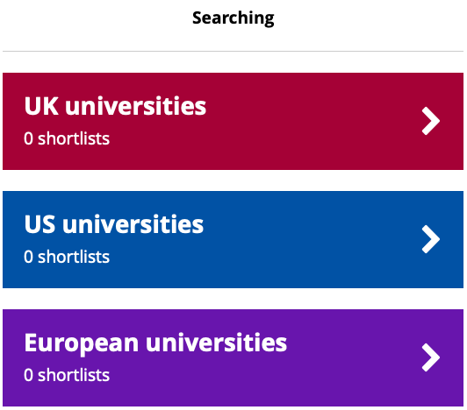
Finding out more about learning pathways
After this lesson, you may wish to find out more about learning pathways.
In the Know-how library, you can read more about the pathways available to you and how to apply for them.
Using the search tools, you can browse specific opportunities.
Notes:
Teacher’s notes:
Know-how library:
Students can find Know-how library guides by logging into their Unifrog accounts and scrolling down to ‘Exploring’ on the Home page until they find the Know-how library. They can search by keywords, e.g. ‘university.’
You can track guides favourited by students by clicking Advanced view>Sort by>Library profiles in Favourites.
Search tools:
Students can create shortlists for opportunities for after school by logging into their Unifrog accounts and scrolling down to ‘Searching’ on the Home page. Depending on your school’s settings, students may need to click ‘All tools’ at the top of their Home page to be able to access the search tools.
You can track shortlists created by students by clicking Advanced view>Sort by>UK uni shortlists / US shortlists / European shortlists / Oxbridge shortlists / Apprenticeship shortlists / UK college shortlists / Canadian shortlists / Asian shortlists / Australasian shortlists / Middle East and Africa shortlists / Irish shortlists / Latin American shortlists / IFP shortlists.

Slide 15
Looking beyond school – next steps (5 mins)
Which of the following pathways would you like to learn more about, and why?
FE college
Sixth form
Apprenticeship
University
Employment
Volunteering
I would like to find out more about __________________________ because…
I’m going to research this pathway by…
university
I’d like to study a veterinary degree in the future.
asking my teachers which university they attended and what they liked most about it.
Notes:
Teacher’s notes:
Students could write down their selected pathway or raise their hand after their selected pathway is read aloud.
Click to reveal example.
Students may wish to link the pathway to their future career goals.
Students may wish to refer to the earlier activity where they identified sources of information about the pathways.
Students may wish to refer to the previous slide which outlines some of the relevant Unifrog tools.

Slide 16


